Slide 1

Revolutionize Your Finances: AI-Powered Income & Expense Tracker
Neha Anil
Master of Applied Artificial Intelligence.

Slide 2

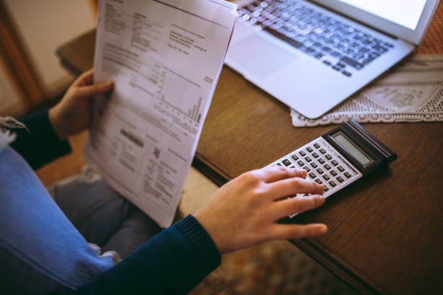
PROBLEM

Slide 3
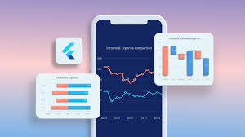
MY SOLUTION
Introducing our AI-powered Income & Expense Tracker. It's your personal finance assistant, designed to:
Track your income and expenses effortlessly
Provide insightful analysis of your spending habits
Predict future expenses using advanced machine learning algorithms

Slide 4
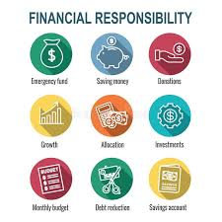
THE BENEFITS
By using our app, you'll enjoy:
Time-saving: Automated tracking and analysis.
Money-saving: Identify areas for cost-cutting and optimize your budget.
Financial peace of mind: Gain control over your finances and achieve your goals.

Slide 5
THANK YOU…
Feel free to contact me if you are interested in working with me or have any suggestions.

